Slide 1
Decimal to Binary Conversion
By
Geetha(FCS)

Slide 2
Binary and Decimal Representation
MSB | Binary Digit |  |  |  |  |  |  | LSB
2⁸ | 2⁷ | 2⁶ | 2⁵ | 2⁴ | 2³ | 2² | 2¹ | 2⁰
256 | 128 | 64 | 32 | 16 | 8 | 4 | 2 | 1

Slide 3
Decimal Digit Value | 256 | 128 | 64 | 32 | 16 | 8 | 4 | 2 | 1
Binary Digit Value | 1 | 0 | 1 | 1 | 0 | 0 | 1 | 0 | 1
So for example, converting a Binary to Decimal number would be:
By adding together ALL the decimal number values from right to left at the positions that are represented by a “1” gives us: (256) + (64) + (32) + (4) + (1) = 357(Base 10) or three hundred and fifty seven as a decimal number.

Slide 4
Example: Convert the decimal number 294₁₀ into its binary number equivalent.

Slide 5
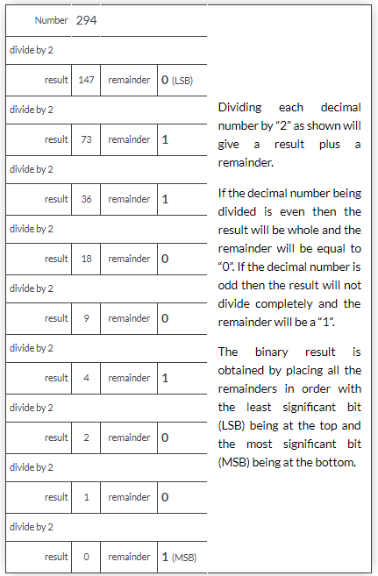

Slide 6
This divide-by-2 decimal to binary conversion technique gives the decimal number 29410 an equivalent of
1001001102 in binary, reading from right to left.
This divide-by-2 method will also work for conversion to other number bases.(base 16,base 8)

